Slide 1
ItP171 IT fundamentals and project
WWW and Internet

Slide 2
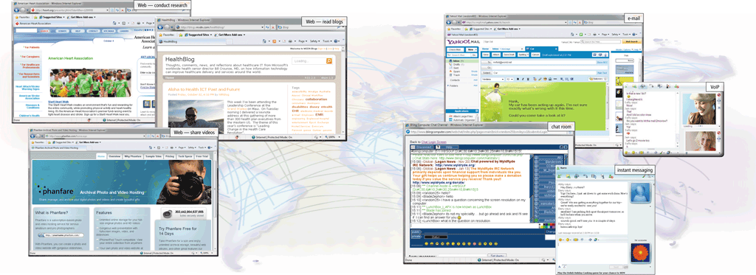
The Internet
The Internet is a worldwide collection of networks that links millions of businesses, government agencies, educational institutions, and individuals

Slide 3
Evolution of the Internet
The Internet originated as ARPANET in September 1969 and had two main goals:
Allow scientists at different physical locations to share information and work together
Function even if part of the network were disabled or destroyed by a disaster

Slide 4
Evolution of the Internet
1969 ARPANET becomes functional
1984 ARPANET has more than 1,000 individual computers linked as hosts
1986 NSF connects NSFnet to ARPANET and becomes known as the Internet
1995 NSFNet terminates its network on the Internet and resumes status as research network
Today More than 550 million hosts connect to the Internet
1996 Internet2 is founded

Slide 5

Internet Explosion

Slide 6
Evolution of the Internet
Many home and small business users connect to the Internet via high-speed broadband Internet service
Cable Internet service
DSL
Fiber to the Premises (FTTP)
Fixed wireless
Cellular Radio Network
Wi-Fi
Satellite Internet Service
Notes:
DSL - DSL stands for Digital Subscriber Line. It is a term used to describe a range of high-speed (broadband) communications services offered over the Public Switched Telephone Network (PSTN). The PSTN uses a pair of copper wires to connect your telephone service to the national telephony network.

Slide 7
Evolution of the Internet
ISP (Internet service provider)
Online service provider (OSP)
Wireless Internet service provider
Regional ISPs provide Internet access to a specific geographical area
National ISPs provide Internet access in cities and towns nationwide
Has many members-only features
Popular OSPs include AOL (America Online) and MSN (Microsoft Network)
Provides wireless Internet access to computers and mobile devices
May require a wireless modem

Slide 8
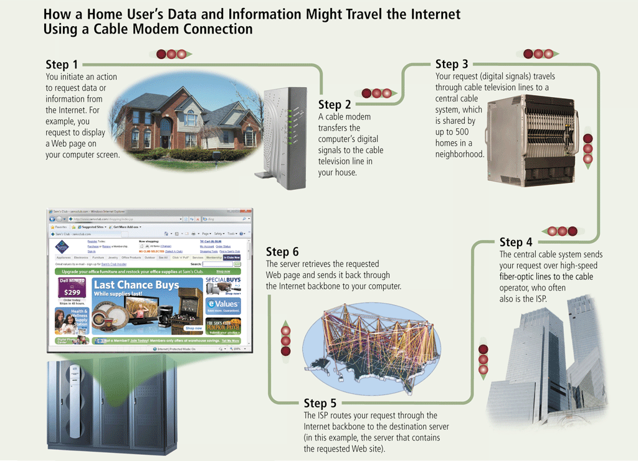
Evolution of the Internet

Slide 9

Internet New Normal

Slide 10

Evolution of the Internet
An IP address is a number that uniquely identifies each computer or device connected to the Internet
A domain name is the text version of an IP address
Top-level domain (TLD)
A DNS server translates the domain name into its associated IP address

Slide 11
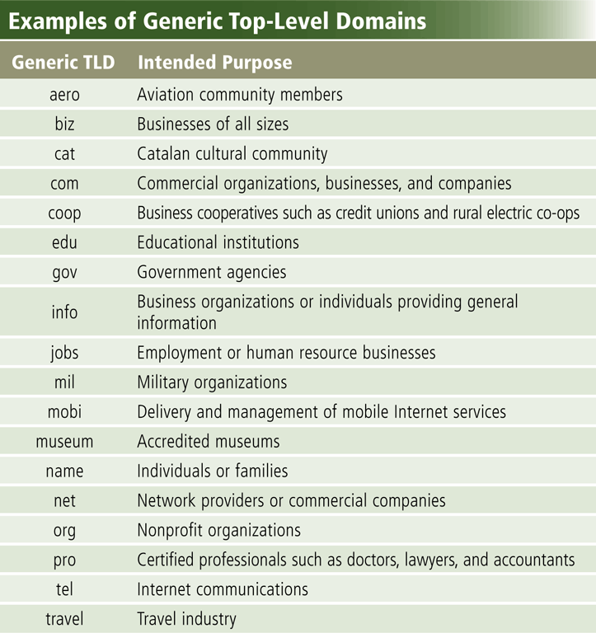
Evolution of the Internet

Slide 12
The World Wide Web
The World Wide Web, or Web, consists of a worldwide collection of electronic documents (Web pages)
A Web site is a collection of related Web pages and associated items
A Web server is a computer that delivers requested Web pages to your computer
Web 2.0 refers to Web sites that provide a means for users to interact

Slide 13
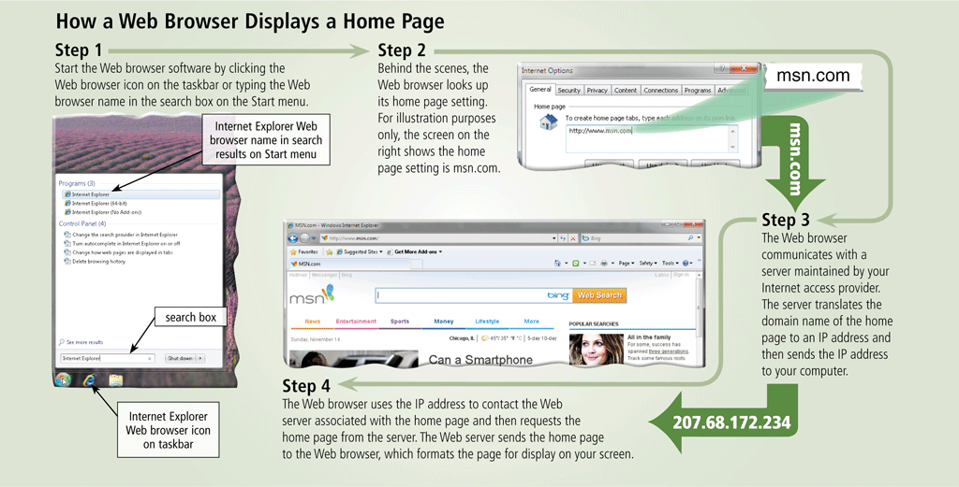
The World Wide Web

Slide 14
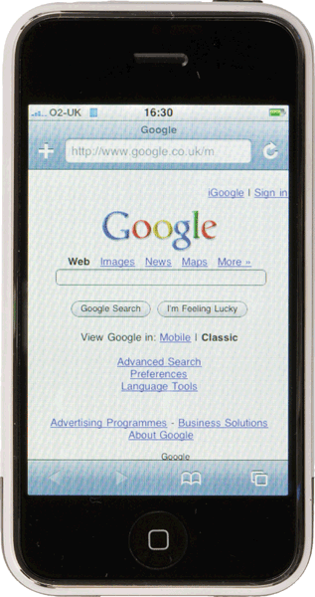
The World Wide Web
A home page is the first page that a Web site displays
Web pages provide links to other related Web pages
Surfing the Web
Downloading is the process of receiving information
Some Web pages are designed specifically for microbrowsers

Slide 15
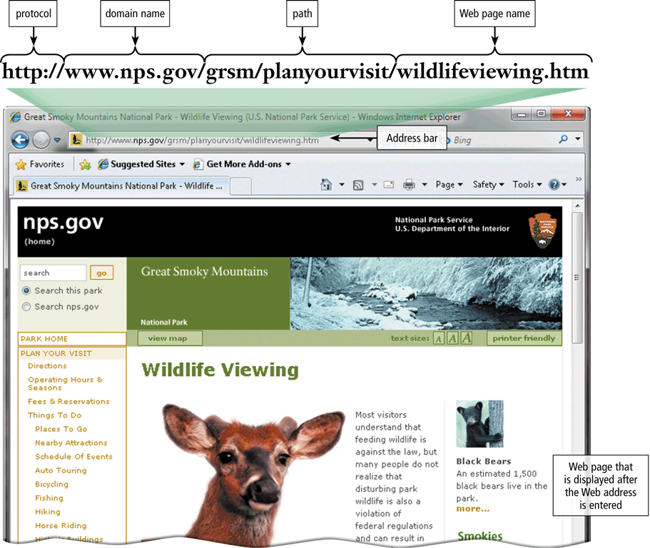
The World Wide Web
A Web page has a unique address called a URL or Web address

Slide 16
The World Wide Web
Two types of search tools are search engines and subject directories
Search engine
Finds information related to a specific topic
Subject directory
Classifies Web pages in an organized set of categories

Slide 17
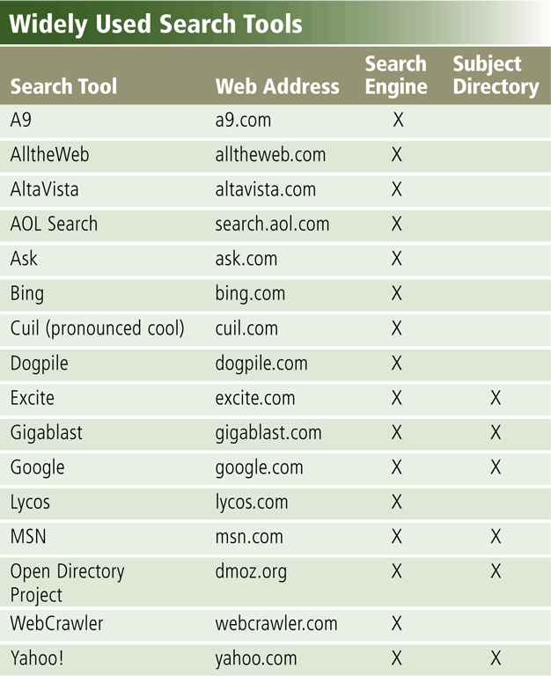
The World Wide Web

Slide 18
The World Wide Web
A search engine is helpful in locating items such as:
Images
Videos
Audio
Publications
Maps
People or Businesses
Blogs

Slide 19
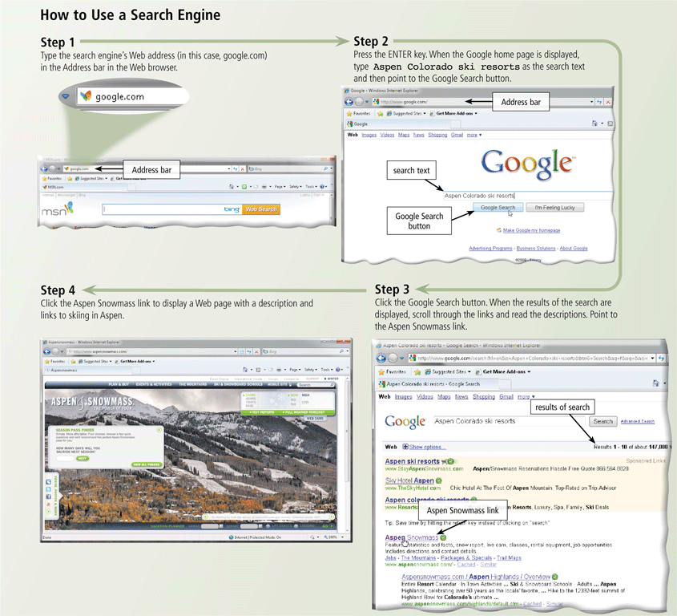
The World Wide Web

Slide 20
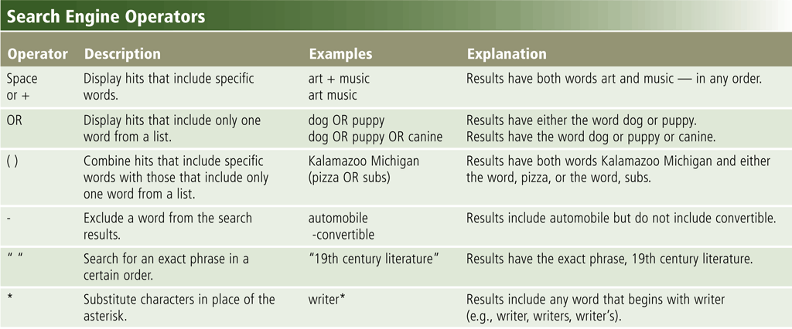
The World Wide Web
Search operators can help to refine your search

Slide 21
The World Wide Web
Multimedia refers to any application that combines text with:
Graphics
Animation
Audio
Video
Virtual Reality

Slide 22
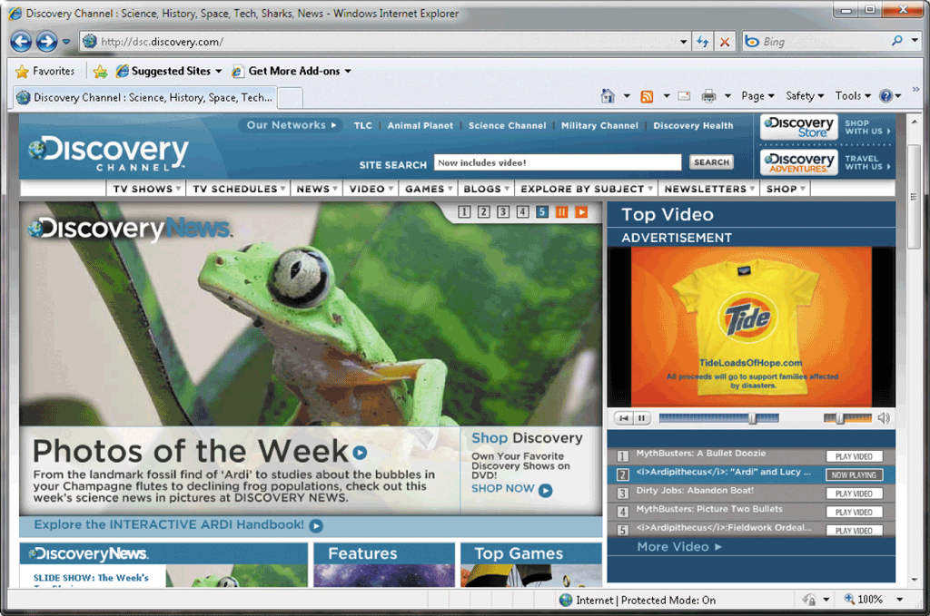
The World Wide Web
A graphic is a digital representation of nontext information
Graphic formats include BMP, GIF, JPEG, PNG, and TIFF

Slide 23
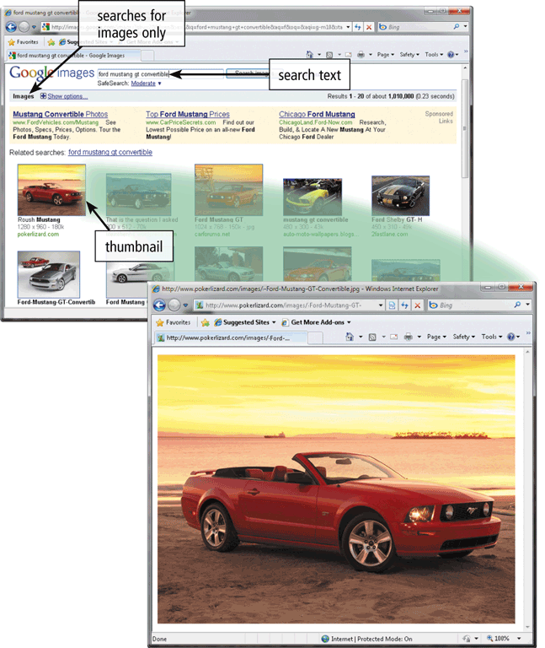
The World Wide Web
A thumbnail is a small version of a larger graphic

Slide 24
The World Wide Web
Animation is the appearance of motion created by displaying a series of still images in sequence

Slide 25
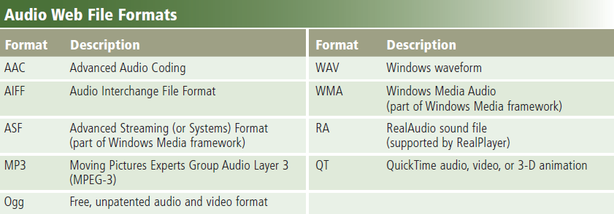
The World Wide Web
Audio includes music, speech, or any other sound
Compressed to reduce file size
You listen to audio on your computer using a player
Streaming is the process of transferring data in a continuous and even flow

Slide 26
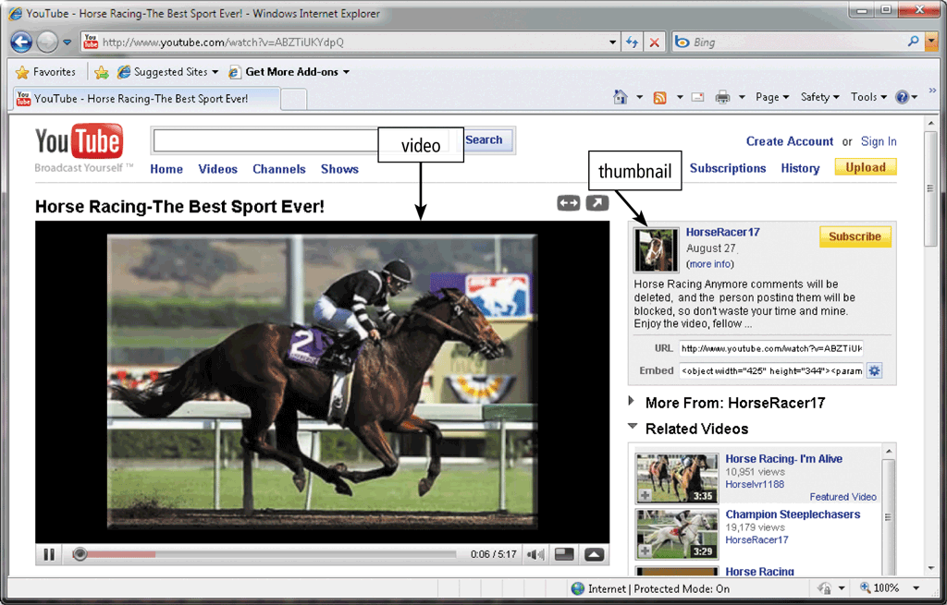
The World Wide Web
Video consists of images displayed in motion

Slide 27
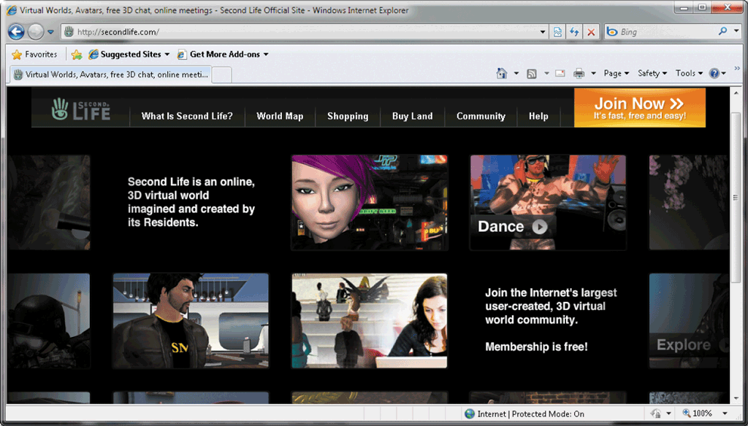
The World Wide Web
Virtual reality (VR) is the use of computers to simulate a real or imagined environment that appears as a three-dimensional space

Slide 28
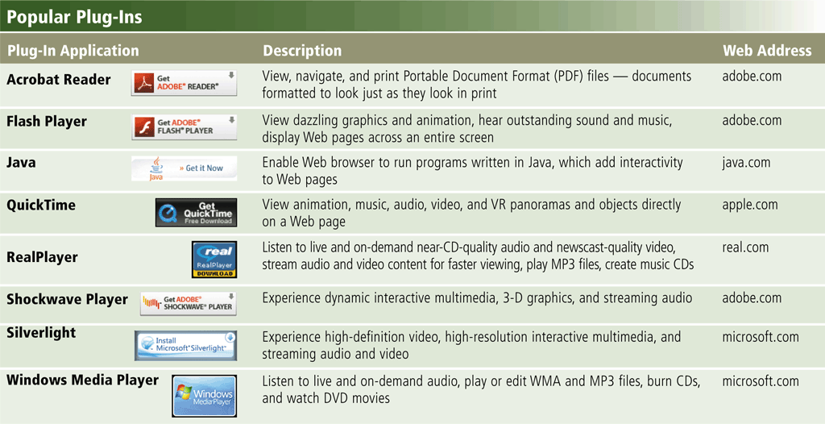
The World Wide Web
A plug-in is a program that extends the capability of a Web browser

Slide 29
The World Wide Web
Web publishing is the development and maintenance of Web pages
Plan a Web site
Analyze and design a Web site
Create a Web site
Deploy a Web site
Maintain a Web site

Slide 30
Conclusion
In this part of the course, we have learned about the plumbing that allows for different machines and people from different parts of the world to communicate
In the next phase of the course, you will learn the nuts and bolts that create this plumbing..
Notes:
Conclusion to course, lecture, et al.

Slide 31
Fun Quiz
Play Kahoot Game:
https://kahoot.it/
Enter NickName: 1_xxx
( for group 1 students)

